Slide 1
Medibase: Medical database for patients
Name and register numbers of the team members:
1. Harshitha S (21011102089)
2. Dhanush Varddhan K (21011102042)
3. A Shama Anjum (21011102001)
4. Harshini Manivannan (21011102038)
Name of the Project Guide: Sundharakumar K B
Shiv Nadar University Chennai

Slide 2
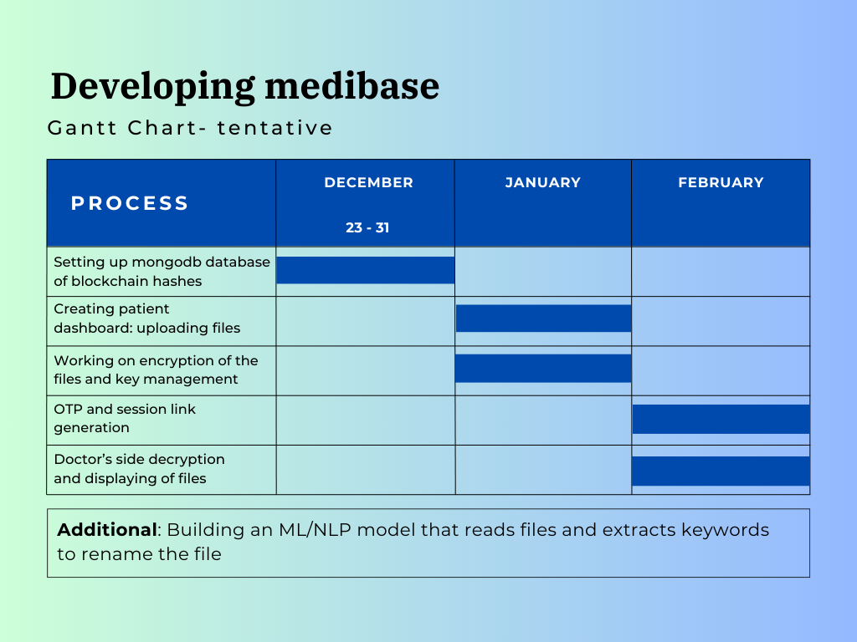
TIMELINE FOR PHASE 2:
Deliverables:
December end:
MongoDB database (backend)
January end:
Fully functioning patient’s side dashboard (front end)
February end:
Fully integrated system (Patient and viewer’s side) (full-stack)

Slide 3
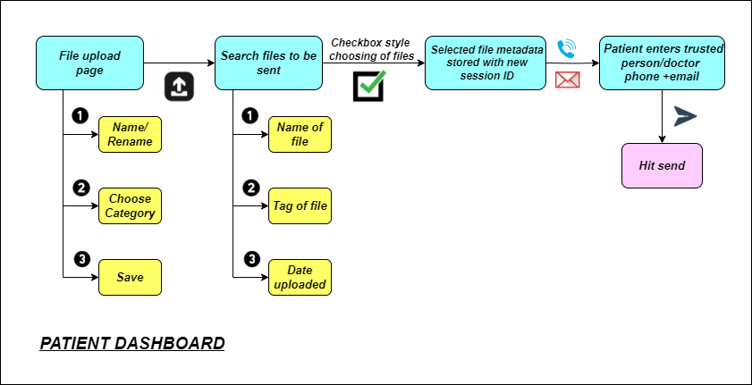
WORKFLOW FOR PHASE 2 (Part 1) – Front-end:

Slide 4
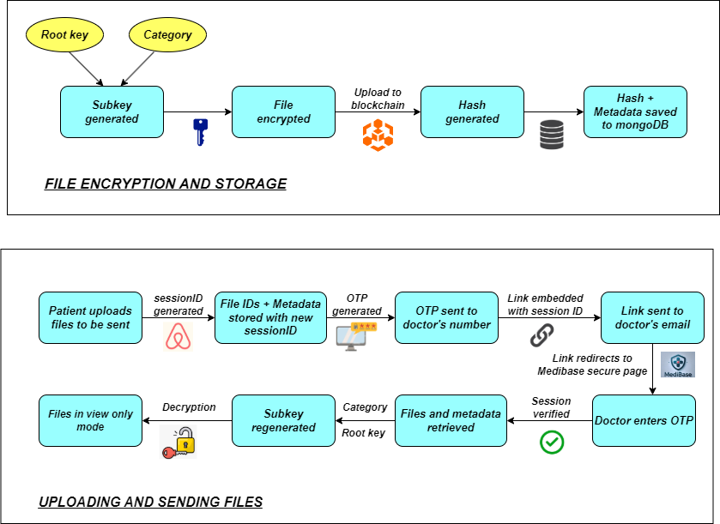
WORKFLOW FOR PHASE 2 (Part 2) – Backend and Integration:

Slide 5
TECH STACK USED:
Frontend:
  React.js: For building the user interface.
  React Router: For navigation.
  Toastify: For notifications
Backend:
  Node.js and Express.js: For API and server management.
  MongoDB with GridFS: For storing and managing encrypted files​
Encryption Algorithm:
  AES (Advanced Encryption Standard): Used for encrypting and decrypting user files with user-specific root keys to ensure data security and privacy​
Testing: Postman for API validation and comprehensive end-to-end testing.

Slide 6
Key Features:
User Authentication:
  Login with credentials.
  Users are assigned unique userIds for personalized file access.
Category Management:
  Add, rename, delete, or retrieve categories.
  Categories are linked to files for organized storage​.
File Management:
  Upload: Users can upload encrypted files with metadata, including category and original filename.
  Download: Files are decrypted before being provided to the user.
  Preview: Recent files are displayed with preview options.
  Delete or Rename: Modify file names or delete files​.
Encryption:
  Files are encrypted and stored in a GridFS bucket to ensure security.
  Unique root keys for each user enable decryption​fileRoutes​.
Responsive Notifications:
  Toast-based notifications for success, error, warning, or informational updates​.

Slide 7
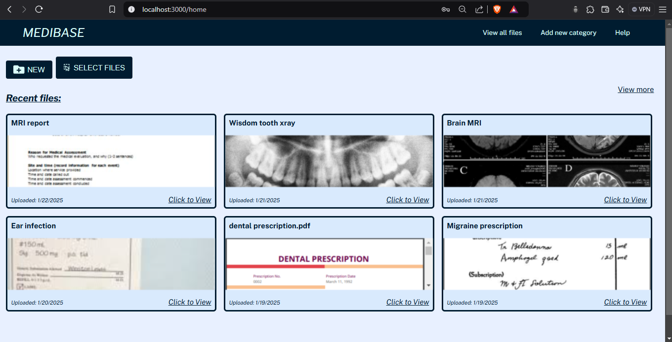
Screenshots – Home page :

Slide 8
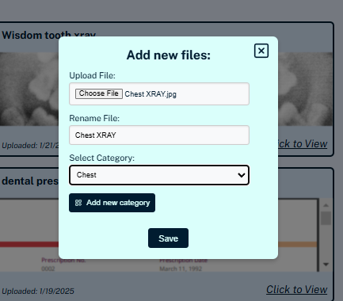
Screenshots – Upload file:

Slide 9
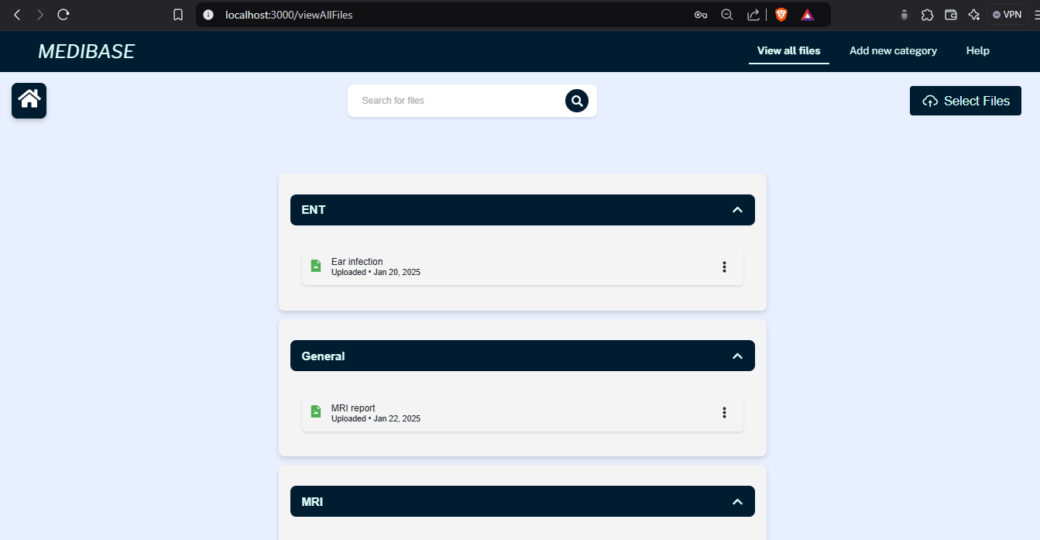
Screenshots – View Files Page :

Slide 10
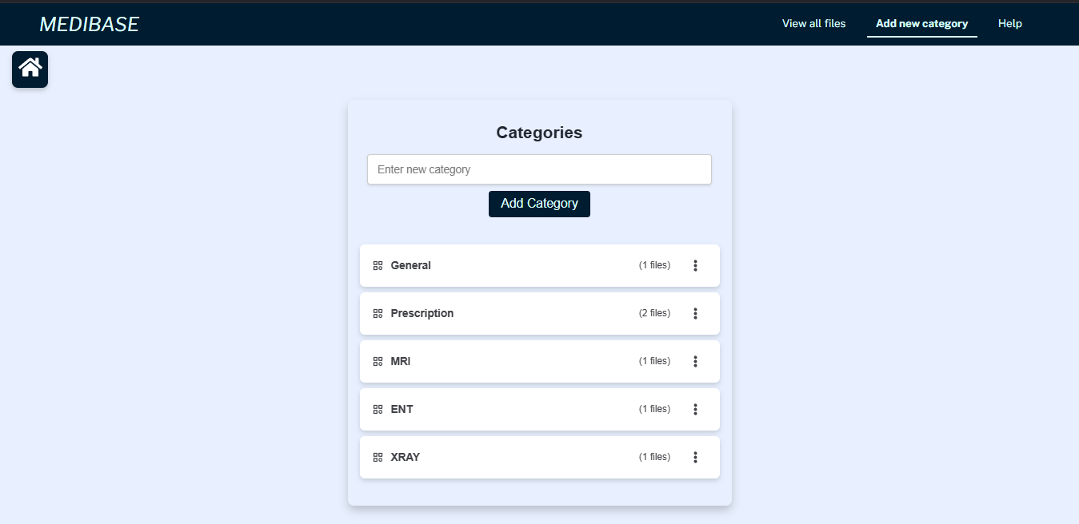
Screenshots – Add Categories page:

Slide 11
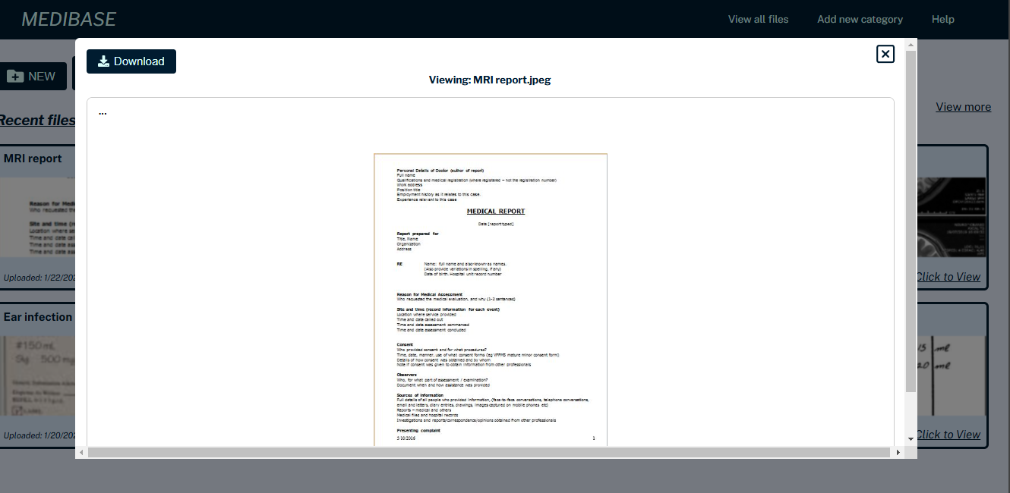
Screenshots – File preview:

Slide 12
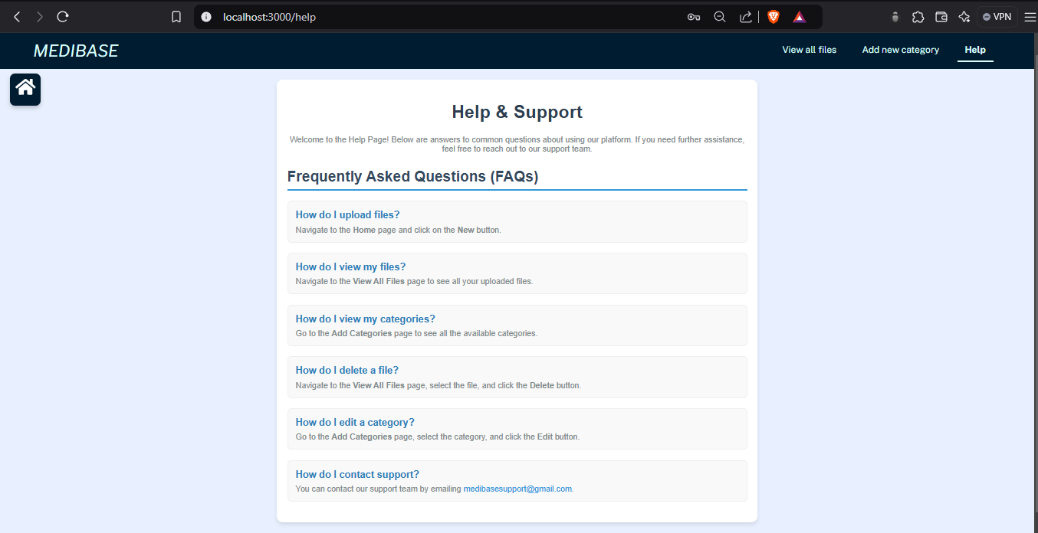
Screenshots – Help page:

Slide 13
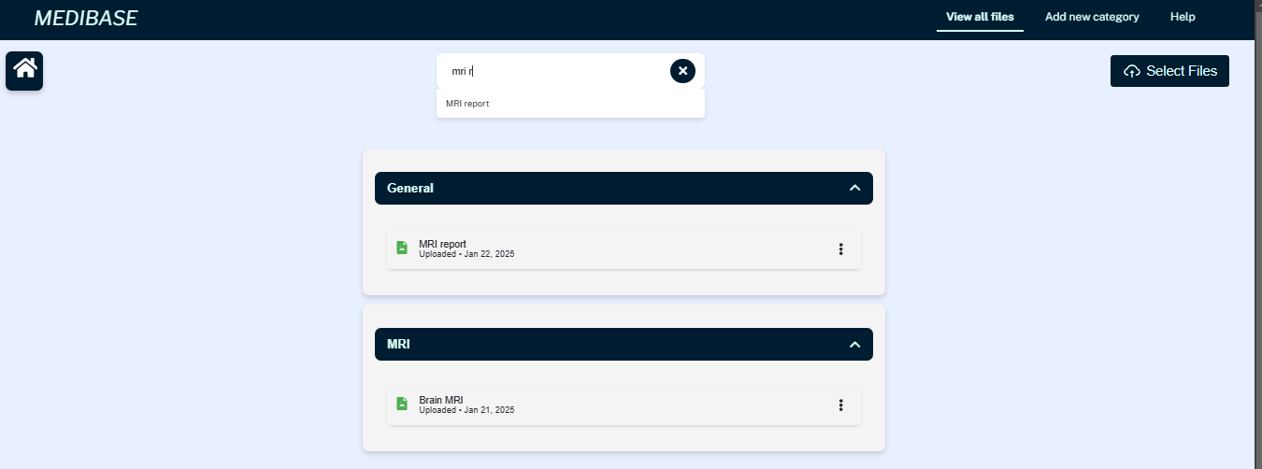
Screenshots – Search Feature:

